Slide 1
Chapter 2
Linear text classification

Slide 2
Question :
“ What is text classification? ”
Answer :
“ Given a text document, assign it a discrete label y ∈ Y, where Y is the set of possible labels.
For example, if we are doing text classification to perform Sentiment Analysis, our Y is a set which includes “positive”, “negative”, and “neutral” semantics.”

Slide 3
Question :
“ Which text classification learning algorithm is best? ”
Answer :
“ It depends on what characteristics are important to the problem you are trying to solve. ”

Slide 4
Question :
“ What is the basic representation of text data for classification? ”
Answer :
“ BOW ”

Slide 5
Question :
“ What are the four linear classifiers for text data? ”
Answer :
“ Naive Bayes, Perceptron, SVM, Logistic Regression ”

Slide 6
The bag of words (BOW)
BOW is a fixed-length document representation → column vector word count
x = [0, 1, 1, 0, 0, 2, 0, 1, 13, 0 . . .] xj is the count of word j
BOW includes only information about the count of each word, and not the order in which the words appear.
To predict a label from a bag-of-words, we can assign a score to each word in the vocabulary, measuring the compatibility with the label. These scores are called weights, and they are arranged in a column vector θ

Slide 7


BOW Classification
Example: To classify news about sports, celebrities, music, and business. → Predict a label yˆ, given the bag of words x, using the weights θ.
For each label y ∈ Y, we compute a score Ψ(x, y), which is a scalar measure of the compatibility between the bag-of-words x and the label y. In a linear bag-of-words classifier, Ψ(x, y) score is the vector inner product between the weights θ and the output of a feature function f(x, y)
This function returns the count of the word “whale” if the label is FICTION, and it returns zero otherwise.

Slide 8


BOW Classification
So the Learning problem is to find right weights for θ based on our classification function:
In the following slides we are gonna exercise different learning algorithms to find the weights θ.
For all these methods we assume our labeled dataset as following:

Slide 9
Naive Bayes
Pros:
easy to implement; estimation is fast, requiring only a single pass over the data; assigns probabilities to predicted labels; controls overfitting with smoothing parameter.
Cons:
often has poor accuracy, especially with correlated features

Slide 10
Probabilistic Classification
Naive Bayes
The joint probability of a bag of words x and it's true label y is written p(x, y).
This approach to classification is to set the weights θ so as to maximize the joint probability of a training set of labeled documents. → maximum likelihood estimation.
In Naive Bayes, the objective is the joint likelihood log p(x (1:N) , y (1:N) ). Maximum likelihood estimation yields a closed-form solution for θ.

Slide 11
Perceptron Classifier
The perceptron is discriminative learning, error-driven algorithm: the learning objective is closely related to the number of errors on the training data.
This classifier is guaranteed to find θ if the dataset is linearly separable meaning that there is a θ so that correctly labels all the training instances.

Slide 12




Perceptron Classifier pt2
Simple Perceptron learning rule:
Run the current classifier on an instance in the training data, obtaining
If the prediction is incorrect: first, Increase the weights for the features of the true label y(i) . Then, decrease the weights for the features of the predicted label
Repeat for all training instances until you have them all correctly classified.

Slide 13

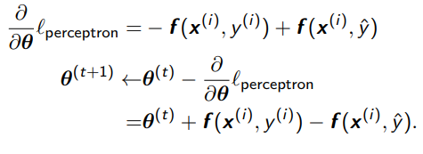
Perceptron Classifier pt3
We can perforform Perceptron as gradient descent. To do that, we need minimize the loss function. Therefore, The perceptron can be viewed as optimizing the loss function:
The gradient of the perceptron loss is part of the perceptron update rules as follow:

Slide 14
Perceptron:
Pros: easy to implement; online; error-driven learning means that accuracy is typically high, especially after averaging.
Cons: not probabilistic; hard to know when to stop learning; lack of margin can lead to overfitting.
Support vector machine:
Pros: optimizes an error-based metric, usually resulting in high accuracy; overfitting is controlled by a regularization parameter.
Cons: not probabilistic.
where probability is not necessary, the support vector machine is usually the right choice

Slide 15

Logistic Regression
Logistic regression combines advantages of discriminative and probabilistic classifiers. Unlike Naive Bayes, which starts from the joint probability pX,Y , logistic regression defines the desired conditional probability pY |X directly.
Think of θ · f(x, y) as a scoring function for the compatibility of the base features x and the label y. To convert this score into a probability, we first exponentiate, obtaining exp (θ · f(x, y)), which is guaranteed to be non-negative. Next, we normalize, dividing over all possible labels y 0 ∈ Y. The resulting conditional probability is defined as:

Slide 16



Logistic Regression
Given a dataset D = {(x (i) , y(i) )} N i=1, the weights θ are estimated by maximum conditional likelihood:
In logistic regression, the objective is the regularized negative log-likelihood.

Slide 17
Logistic regression:
Pros: error-driven and probabilistic; overfitting is controlled by a regularization parameter, regularized.
Cons: batch learning requires black-box optimization; logistic loss can “overtrain” on correctly labeled examples.
When probability is necessary, logistic regression is usually more accurate than Naive Bayes.

Slide 18
Chapter 3
Nonlinear classification

Slide 19
Question :
“Recently, nonlinear classifiers have swept through NLP, and are now the default approach, WHY? ”
Answer :
“1. Rapid advances in deep learning nonlinear methods learning complex functions through multiple layers.
2. Incorporation of Word Embeddings as dense vector representation of words
3. Rapid advances in high speed computation using GPUs. ”

Slide 20
Nonlinear Text Classification
In this chapter we are explore a bit about Feedforward neural networks motivation, architecture, Activation functions, and the Inputs and outputs of model.
Then we take a look at the procedure of learning neural networks, the backpropagation algorithm.
After that, we look at neural networks architectures for sequence data and the reason why they are good models for text classification.

Slide 21
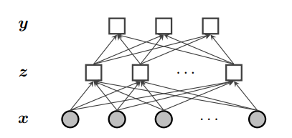
Feedforward neural networks
Example : Consider the problem of building a classifier for movie reviews. The goal is to predict a label y ∈ {GOOD, BAD, OKAY} from a representation of the text of each document, x
Z is the vector of features and a hidden layer.
We can have multiple hidden layers, z1 , z2 , . .adding even more expressiveness.
z =[z1,z2, ... , zKz]

Slide 22

Feedforward neural networks pt2
If we assume that each zk is binary, zk ∈ {0, 1}, then the probability p(zk | x) can be modeled using binary logistic regression where σ is the sigmoid function. Also weight matrix Θ(z→y) is based on concatenation

Slide 23
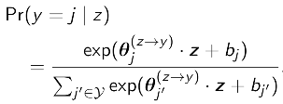

Feedforward neural networks pt3
To predict y from z we use logistic regression.

Slide 24
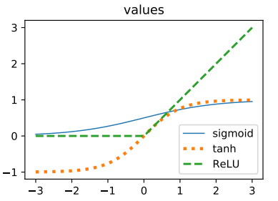
Activation Functions
The sigmoid function used to find z , and it is a activation function. We can use different functions for this purpose as well, for example:
The rectified linear unit ReLU(a) = max(0, a), which is fast to evaluate and easy to analyze.
The hyberbolic tangent tanh, which is centered at zero, helping to avoid saturation.

Slide 25

Output and Loss function
The softmax output activation is used in combination with the negative log-likelihood loss, like logistic regression.
Consider ey(i) = [0, 0,... , 0, 1 , 0, ... ,0], as one-hot vector.

Slide 26





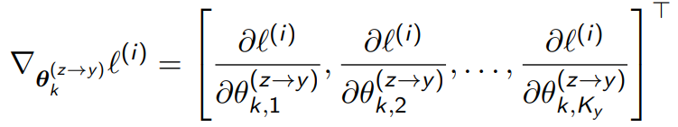
Gradient descent in neural networks
Neural networks are learned by batch gradient descent.
is the loss on instance batch i.
is the learning rate at update t
is the gradient of the loss with respect to the column vector of output weights

Slide 27
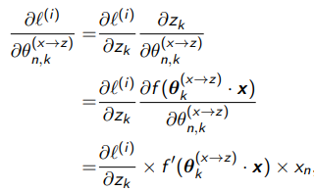
Backpropagation in neural networks
Using the Backpropagation, we compute a loss on y, and apply the chain rule of calculus to compute a gradient on all parameters.

Slide 28
Sequence Data
If we consider a text as a sequence of words w1,w2, ... ,wM. Using some structures like BOW will destroy the context behind the text. Therefore, the sequence of words should be modeled.
Neural architectures suitable for sequence data are listed as following:
Convolutional Neural Networks, which is sensitive to local dependencies between words.
Recurrent Neural Networks, which is a model of context is constructed while processing the text from left-to-right. These networks are sensitive to global dependencies.
Self-attentional Networks, which model of context is adaptive: each word can choose its own context.

Slide 29
Chapter 4
Linguistic application of classification

Slide 30
Question :
“What are the classical application of text classification?”
Answer:
“ Sentiment and opinion analysis, and Word sense disambiguation”

Slide 31
Sentiment analysis
Sentiment analysis is a classical application of text classification, and is typically approached with a bag-of-words classifier.
Now let's define the sentiment of a text and what do we mean by that?
The sentiment behind a text refers to the author’s subjective or emotional attitude towards the central topic of the text.
Some good examples of semantics behind natural language texts can be found in:
In consumer reviews of a product or service, the sentiment behind the review may align with a 1-5 star rating.
In political statements, the sentiment may reflect a favorable/ unfavorable view toward a proposed policy

Slide 32
Sentiment analysis pt2
As we mentioned, a typical way to approach sentiment analysis is through BOW classification. However, there are some cases of linguistic phenomena which require more complex modeling.
Some examples of such linguistic phenomena are provided here for clarification; in these examples we can clearly see that using double negation in speech or sometimes slangs will require more complex classifier than BOW to figure out the sentiment behind one’s sentence.
Example 1 → It would be nice if you acted like you understood.
Example 2 → That’s not bad for the first day.
Example 3 → It's not like I don't agree with your teacher.

Slide 33

Word sense disambiguation
Many words have multiple senses, or meanings. The semantic behind those texts which consisting of of multi-sense words, will associate with only one of the senses of those words.
For example, the verb appeal has different senses. The real question is how a model can find out the correct sense of the verb appeal in the following text.
Text → “Prostitutes appeal to Pope”

Slide 34
Word sense disambiguation pt2
Word senses disambiguation is the problem of identifying the intended word sense in a given context.
Senses are properties of lemmas which are uninflected word forms, and are grouped into synonym sets called synsets.
These synsets are collected and annotated in WordNet. WordNet consists of roughly 100,000 synsets, which are groups of lemmas (or phrases) that are synonymous.
WordNet defines the scope of the word sense disambiguation problem, and, more generally, formalizes lexical semantic knowledge of English.

Slide 35
Word sense disambiguation pt3
WordNet also describes many other lexical semantic relationships in addition to synonymy, including:
Antonymy: x means the opposite of y, e.g. FRIEND-ENEMY
Hyponymy: x is a special case of y, e.g. RED-COLOR; the inverse relationship is hyponymy
Meronymy: x is a part of y, e.g., WHEEL-BICYCLE; the inverse relationship is holonymy.
Classification of these relations can be performed by searching for characteristic patterns between pairs of words.

Slide 36
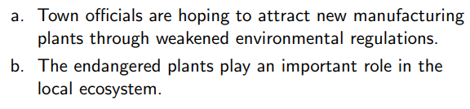
Word sense disambiguation as Classification
Consider the the mentioned two texts bellow, different senses of word “plants” has been used in each sentences. How can we tell living plants from manufacturing plants?

Slide 37

Word sense disambiguation as Classification pt2
Now lets build a feature vector using the bag-of-words representation, by treating each context as a pseudo-document. The feature function can be represented as following:

Slide 38
Word sense disambiguation as Classification pt3
As in document classification, many of these features are irrelevant, but a few are very strong predictors.
To go beyond the bag-of-words, one might encode the position of each context word with respect to the target. These are called collocation features, and they give more information about the specific role played by each context word.
A semantic concordance is a corpus in which each open-class word (nouns, verbs, adjectives, and adverbs) is tagged with its word sense from the target dictionary or thesaurus

Slide 39
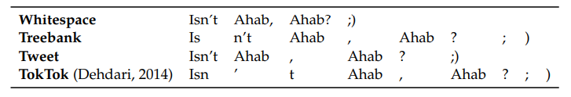
Tokenization
The first subtask for constructing a bag-of-words vector is Tokenization.
Tokenization is the language-specific task of splitting the input into discrete tokens.
A simple approach is to define a subset of characters as whitespace, and then split the text on these tokens.
Text → “Isn’t Ahab, Ahab? ;) “

Slide 40
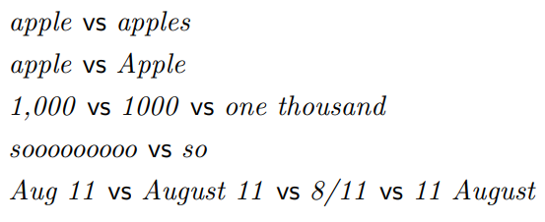
Normalization
After splitting the text into tokens, the next question is which tokens are really distinct.
For example, sentence-initial capitalization may be irrelevant to some classification tasks.
The complete elimination of case distinctions will result in a smaller vocabulary, and thus smaller feature vectors.
Other than Normalization, there are aggressive ways to group words like Stemming and Lemmatization.

Slide 41
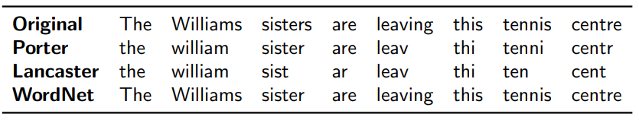
Stemmer and Lemmatizer
A stemmer is a program for eliminating affixes, usually by applying a series of regular expression substitutions.
There are different stemming and Lemmatizer algorithms, the most popular ones are “Porter”, “Lancaster” , and “WordNet”.
Lemmatizers are systems that identify the underlying lemma of a given wordform. They must avoid the over-generalization errors of the stemmers.

Slide 42
Stopwords
Another way to reduce the size of the feature space is to eliminate stopwords such as “the”, “to”, and “and”, which may seem to play little role in expressing the topic, sentiment, or stance.
This is typically done by creating a stoplist (e.g., NLTK.CORPUS.STOPWORDS), and then ignoring eliminating all terms that match the list from the text.

Slide 43
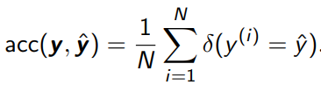
Evaluating your Classifier
Similar to any supervised machine learning application, we use our reserved balanced testing data to evaluate the overall accuracy of our model.
Other than “accuracy” which indicates how often our model is right, we need additional metrics for further analysis on the response of our model on testing set.

Slide 44
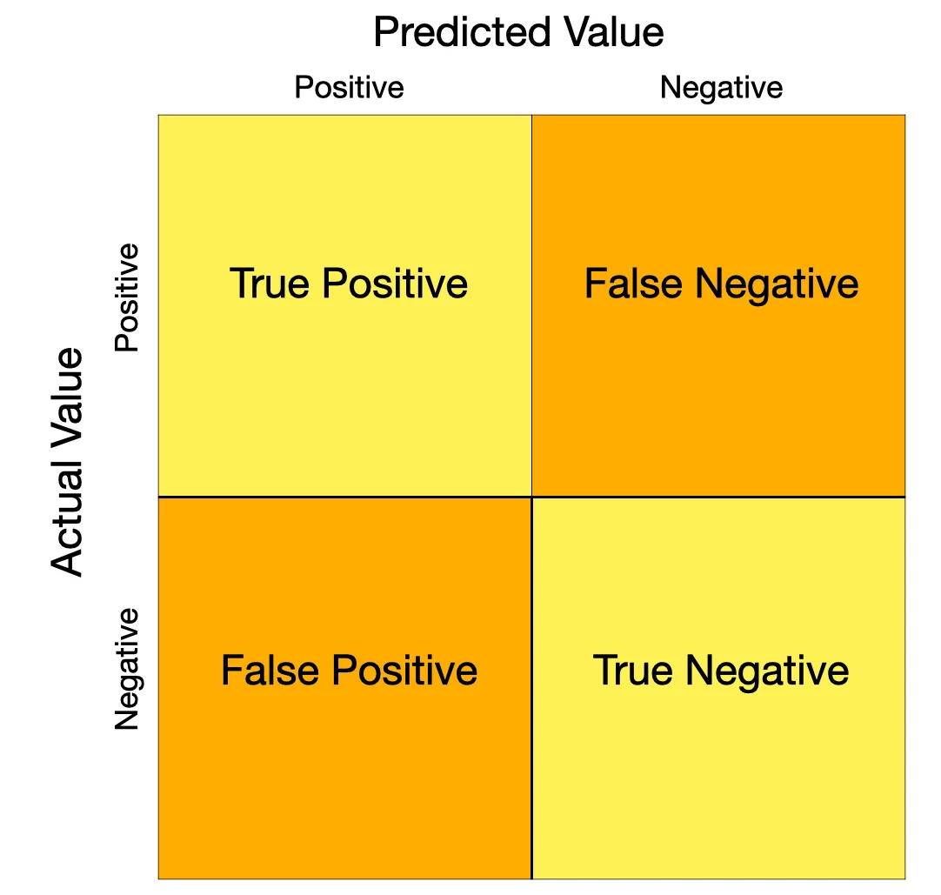
Other Evaluating Metrics
False positive: the system incorrectly predicts the label.
False negative: the system incorrectly fails to predict the label.
True positive: the system correctly predicts the label.
True negative: the system correctly predicts that the label does not apply to this instance.
Recall and precision are defined in terms of these counts, and distinguish between the two types of errors.

Slide 45



Recall, Precision,and their Combination
Recall and precision n imply binary classification as they are defined in terms of FP, FN, TP,TN counts.
Recall is the fraction of positive instances which were correctly classified.
Precision is the fraction of positive predictions that were correct.
F-measure can be defined as the combination of Recall and Precision when they are weighted equally.

Slide 46
Evaluating Multi-class Classification
In multi-class classification, each instance is positive for one class, and negative for all other classes.
Macro F-MEASURE is the average F-MEASURE across several classes.
In multi-class problems with unbalanced class distributions, the macro F-MEASURE is a balanced measure of how well the classifier recognizes each class. This treats all classes equally, regardless of their frequency as its balanced across classes.

Slide 47
Evaluating Multi-class Classification pt2
In Micro F-MEASURE, we compute true positives, false positives, and false negatives for each class, and then add them up to compute a single recall, precision, and F-MEASURE. This metric is balanced across instances rather than classes, so it weights each class in proportion to its frequency. This emphasizes performance on high-frequency classes.

Slide 48
Classifier Comparison
Suppose we have learned multiple models to solve our problem and we achieved different accuracy values for each. How can we compare them with each other?
The main aim of hypothesis testing is to determine whether the difference between two statistics, for example, the accuracies of two classifiers,is likely to arise by chance.
We will be concerned with chance fluctuations that arise due to the finite size of the test set.

Slide 49
Classifier Comparison pt2 : Hypothesis testing
Example: Suppose two model classifiers to solve a problem, first model, C1 gets 82% accuracy with 1000 examples in the test set, and second model C2 gets 73% accuracy with 11 examples in the test set.
Now let's consider two hypotheses that explain the observed data:
H0 → C1 is not more accurate than C2, and its superior performance on the test set was due only to luck. This is the null hypothesis.
H1→ C1 is more accurate than C2, and therefore can be expected to be more accurate in the future (in the limit of an infinite number of independent evaluations).

Slide 50
Classifier Comparison pt2 : Hypothesis testing
C1 gets 82% accuracy with 1000 examples in the test set.
C2 gets 73% accuracy with 11 examples in the test set.
H0 → C1 is not more accurate than C2, and its superior performance on the test set was due only to luck. This is the null hypothesis.
H1→ C1 is more accurate than C2, and therefore can be expected to be more accurate in the future (in the limit of an infinite number of independent evaluations).
If the test set is small, H0 might be true. If the test set is large, the probability of observing a 9% difference in accuracy becomes vanishingly small unless C1 really is more accurate. These probabilities are quantified by hypothesis testing.

Slide 51

Classifier Comparison pt3: The Binomial test
The statistical significance of a difference in accuracy can be evaluated using classical tests, such as the binomial test.
Under the null hypothesis, when the classifiers disagree, each classifier is equally likely to be right so θ=0.5. Therefore, among N disagreements, c1 is correct k < N/2 times.

Slide 52
Classifier Comparison pt3: The Binomial test
Suppose that classifiers c1 and c2 disagree on N instances in a test set with binary labels, and that c1 is correct on k of those instances.
Under the null hypothesis that the classifiers are equally accurate, we would expect k/N to be roughly equal to 1/2, and as N increases, k/N should be increasingly close to this expected value. These properties are captured by the binomial distribution, which is a probability over counts of binary random variables.

Slide 53
Building datasets
If you want to build a classifier, sometimes you must first build a dataset of your own.
The goal is to build a system that will work across a broad range of documents. In this case, it is best to have a balanced corpus, with contributions from many styles and genres.
Sometimes building corpus or dataset includes selecting a set of documents or instances to annotate, and then performing the annotations.
One important part of building a balanced corpus is to get the labels of the dataset.
Text classification relies on large datasets of labeled examples by exploiting metadata to obtain labels , or using annotations as the labels.

Slide 54
Building datasets: Labeled dataset
Text classification relies on large datasets of labeled examples. There are two ways to get labels.
By exploiting existing metadata to obtain labels. Metadata sometimes tell us exactly what we want to know.
Using annotations as the labels must be annotated, either by experts or by novice “crowdworkers.”

Slide 55
Chapter 5
Learning without supervision

Slide 56
Unsupervised learning
Consider the problem of word sense disambiguation were a word can have different sensed or meanings.
The goal is to classify each instance of a word into a sense.
Question:
If the labels are missing from our dataset, Is it possible to learn anything about these different senses without labeled data?

Slide 57
Unsupervised learning
Question:
If the labels are missing from our dataset, Is it possible to learn anything about these different senses without labeled data?
Solution:
Clustering algorithms are capable of finding different context groups. These algorithms assign each data point to a discrete cluster or category, zi ∈ 1, 2, . . . K.

Slide 58
K-means clustering
K-means is an iterative algorithm that maintains a cluster assignment for each instance, and a central (“mean”) location for each cluster.
K-means iterates between updates to the assignments and the centers:
Each instance is placed in the cluster with the closest center.
Each center is recomputed as the average over points in the cluster.
In K-means, the converged solution depends on the initialization, and a better clustering can sometimes be found simply by re-running the algorithm from a different random starting point.

Slide 59
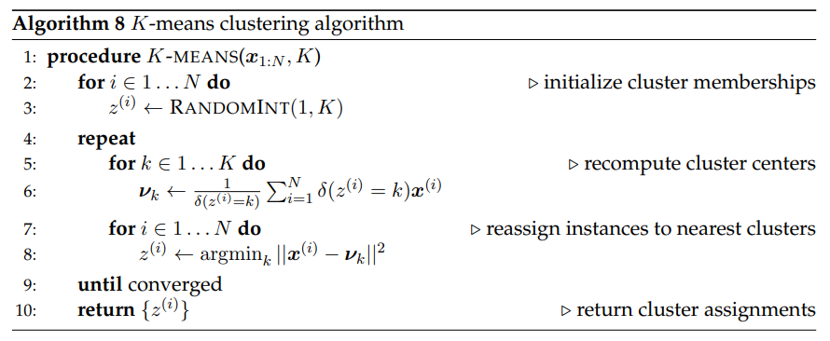
K-means clustering pt2

Slide 60

Soft K-means
Soft K-means is a particularly relevant variant. Instead of directly assigning each point to a specific cluster, soft K-means assigns to each point a distribution over clusters.
The soft weight qi(k) is computed from the distance of xi to the cluster center νk. In turn, the center of each cluster is computed from a weighted average of the points in the cluster

Slide 61
Expectation-Maximization (EM)
Expectation-maximization combines the idea of soft K-means with Naıve Bayes classification as its an iterative algorithm to find the maximum local likelihood.
The Expectation-maximization iteration alternates between performing an expectation E-step, which creates a function for the expectation of the log-likelihood evaluated using the current estimate for the parameters, and a maximization M-step,which computes parameters maximizing the expected log-likelihood found on the E step.

Slide 62
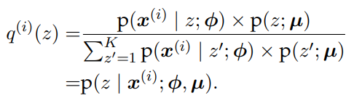
Expectation-Maximization (EM) : The E-step
The step in which we update q (i) is known as the E-step, because it updates the distribution under which the expectation is computed.

Slide 63
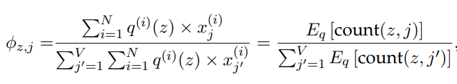

Expectation-Maximization (EM) : The M-step
Next, we hold fixed the soft assignments q (i) , and maximize with respect to the parameters, φ and µ. The parameter φ is a distribution over words for each cluster.

Slide 64
How many clusters?
So far, we have assumed that the number of clusters K is given.
Question:
How can we find the K value systematically?
Solution:
To choose the number of clusters:
To maximize a metric of clustering quality.
Akaike Information Crition.

Slide 65
Applications of expectation-maximization
Expectation-maximization is a framework for learning with missing data.
We can find EM applications on :
Word sense induction
Semi-supervised learning
Multi-component modeling

Slide 66
Semi-supervised learning
In semi-supervised learning, the learner makes use of both labeled and unlabeled data.
Expectation-maximization can be applied to the problem of semi-supervised learning, by learning from both labeled and unlabeled data in a single model.
Semi-supervised learning makes use of annotated examples, ensuring that each label y corresponds to the desired concept. One method is by adding unlabeled examples, it is possible cover a greater fraction of the features than would appear in labeled data alone.

Slide 67
Semi-supervised learning : Multi-view learning
EM semi-supervised learning can be viewed as self-training.
In self-training, the labeled data guides the initial estimates of the classification parameters; these parameters are used to compute a label distribution over the unlabeled instances, q (i) ; the label distributions are used to update the parameters.
The risk is that self-training drifts away from the original labeled data. This problem can be ameliorated by multi-view learning.

Slide 68
Multi-view learning
Co-training is an iterative multi-view learning algorithm, in which there are separate classifiers for each view.
At each iteration, each classifier predicts labels for a subset of the unlabeled instances, using only the features available in its view. These predictions are then used as ground truth to train the classifiers associated with the other views. If the views are truly independent, this procedure is robust to drift. Furthermore, it imposes no restrictions on the classifiers that can be used for each view.
Word-sense disambiguation is particularly suited to multi-view learning

Slide 69
Semi-supervised learning: Graph-based algorithms
Another family of approaches to semi-supervised learning begins by constructing a graph, in which pairs of instances are linked with symmetric weights ωi,j.
The goal is to use this weighted graph to propagate labels from a small set of labeled instances to larger set of unlabeled instances.

Slide 70

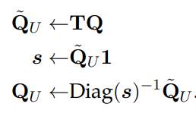
Graph-based algorithms
In label propagation, this is done through a series of matrix operations. Let Q be a matrix of size N × K, in which each row q (i) describes the labeling of instance i. When ground truth labels are available, then q(i) is an indicator vector. Let Ti,j represent the “transition” probability of moving from node j to node i.
We compute values of Ti,j for all instances j and all unlabeled instances i, forming a matrix of size NU × N. We can then “propagate” the label distributions to the unlabeled instances.

Slide 71
Chapter 6
Language models

